Slide 1
Optimization of Extrusion Dies using polyXtrue and OptiXtrue Software
M. Gupta

Slide 2
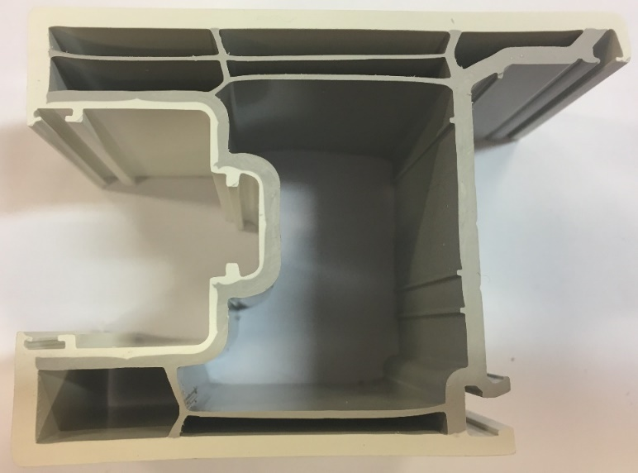
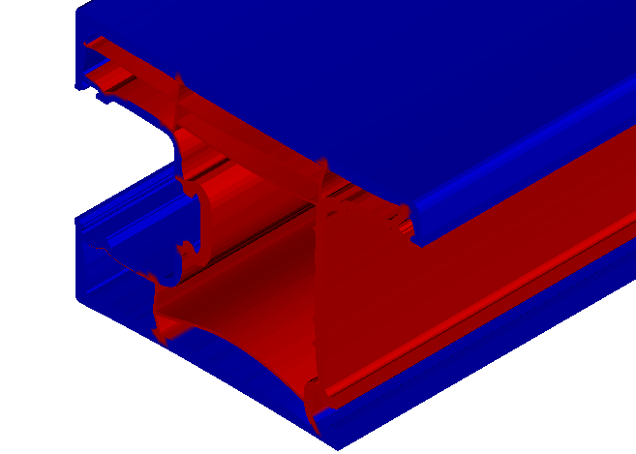
Layer structure in extruded profile
Window profile die
Predicted layer structure accurately matches with the layer structure in the extruded profile
Predicted layer structure

Slide 3
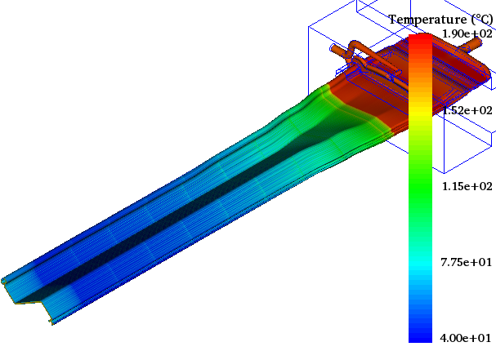
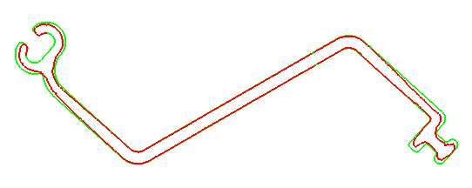
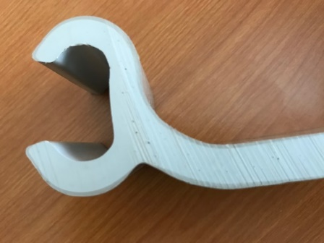
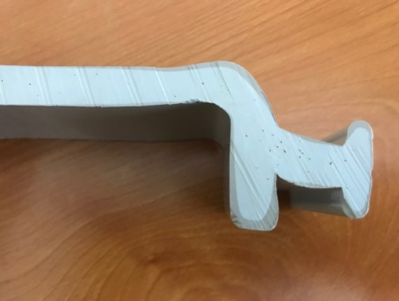
Transformation of a straight profile at die exit to z-shaped profile in calibrators
Predicted extrudate profile
Predicted Interface shape (layer structure)
Cap layer
Cap layer

Slide 4
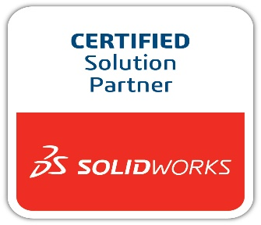
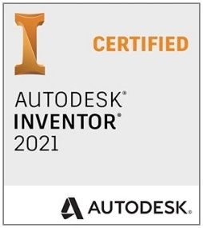
Generation of parameterized die geometry (SolidWorks, Inventor)
Simulation of the flow in the parameterized die (polyXtrue)
Estimation of the improved values of the parameterized dimensions for minimum exit velocity deviation (optiXtrue)

Slide 5
Free pay-per-execution (PPX) version available
https://plasticflow.com/PPXDownload.php
Contact Information
E-mail: support@plasticflow.com
Phone: (906) 483-0691
Web: www.plasticflow.com

